Slide 1
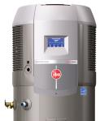
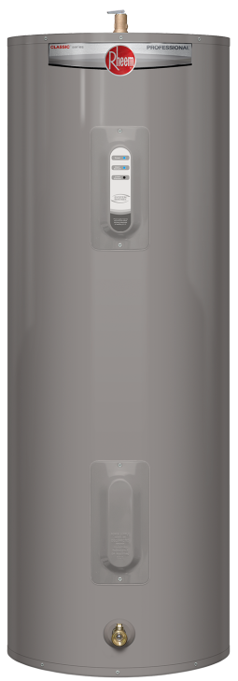
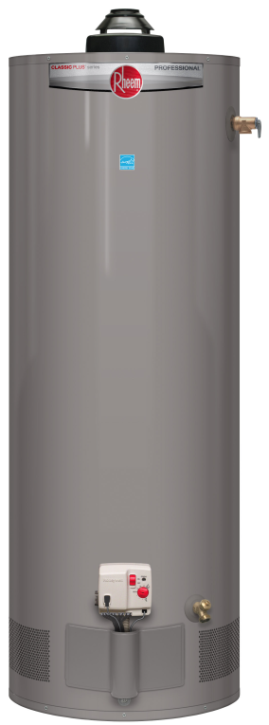
Rheem Residential Water Heating Professional Product Line
RESIDENTIAL WATER HEATING PRODUCTS
January 2014
Includes New Pr fessional Product Line
Earn More ProClub Points!

Slide 2
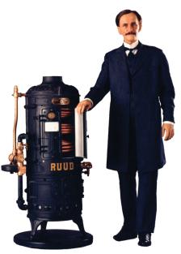
The Original
Invented in 1889 by Edwin Ruud
First ‘automatic’ water heater
Public debut in 1903
Later Rheem acquired Ruud patents and its distribution network
Original1900 Ruud Water Heater
1950’s Water Heater
Notes:
Edwin Ruud, a Norwegian mechanical engineer was the inventor of the automatic storage water heater in 1889. Ruud emigrated to Pittsburgh where he pioneered the early development of both residential and commercial water heaters. An engineer by trade and a machinist by training, Edwin Ruud invented the first automatic water heater while working with the Westinghouse Electric and Manufacturing Company in Pittsburgh, Pennsylvania. In 1890, Westinghouse received patents for the first gas fired automatic water heater designed by Ruud.
When Westinghouse lost interest in the patents, Ruud purchased them back for $380. After a decade of design refinements, the first instantaneous gas fired water heater made its public debut in the St. Louis World’s Fair in 1903. It wasn’t long before magazines such as the Saturday Evening Post was advertising the Ruud gas water heater with its slogan “Turn on the faucet, Ruud does the rest”.
In the decades that followed, and thru the 50’s, Ruud Manufacturing Company continued to be an industry leader in water heating technologies commercial, as well as residential, products.
Meanwhile, in Emeryville, California, brothers Dick and Donald Rheem formed a galvanized drum company.

Slide 3
Rheem Profile
Rheem® Manufacturing Company began in 1927 by the Rheem brothers
Rheem was a supplier of packaging to the petroleum industry
In 1959 Rheem acquired Ruud, a pioneer in the water heating industry with a well-regarded products and a distribution network throughout North America
3
Notes:
Rheem was founded by two brothers back in the late 1920’s. Over the course of the last 75 years, the company has gone through many changes but remains a strong, well diversified company.

Slide 4
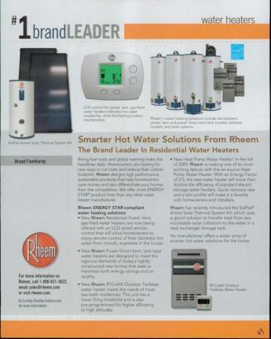
The Value of the Rheem Brand
Rheem brand has been voted the most familiar brand year after year
Strong brand recognition with consumers and within the trade
Trusted name for quality and unsurpassed reliability
4
Notes:
The Rheem brand has been voted most familiar brand for more than 25 years.

Slide 5
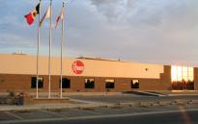
Rheem Water Heating Facilities
Montgomery, Alabama Customer Care Center
Brampton, Ontario Sales & Marketing
Montgomery, Alabama Manufacturing Facility
Mexicali, Mexico Manufacturing Facility
Corporate Headquarters
Atlanta, Georgia
Montgomery plant built in 1971
Principal manufacturing facility
Over 650,000 square feet under roof
Montgomery, Alabama WHD Headquarters
Nuevo Laredo, Mexico Manufacturing Facility
5

Slide 6
Rheem Advantage Multiple Plant Locations
Rheem provides the products you need… when you need them!
Mexicali, MX
Montgomery, AL
Nuevo Laredo, MX
6
Notes:
To provide you with the fastest product delivery, our water heating plants are distribute across North America.

Slide 7
Rheem Advantage Multiple Plants and Warehouses
Water Heater Plants (3)
Rheem Warehouses (5)
Public Warehouse (5)
Other Rheem Divisions
Five Public Warehouses Alsip, IL Jersey City, NJ
Aurora, CO Plant City, FL
Durham, NC
7
Notes:
We have (3) Rheem-Ruud Water Heater Plants and (5) Rheem-Ruud Warehouses
Montgomery, AL plant and warehouse
Nuevo Laredo plant and warehouse
Mira Loma warehouse
Mexicali plant Lewisville, Texas warehouse
Brampton, Ontario
In addition, we have (5) Public Warehouses in …
Alsip, IL
Aurora, CO
Durham, NC
Jersey City, NJ
Plant City, FL
The Rheem Family includes:
Water Heating Division Headquarters, Montgomery, AL
Rheem Water Heating – Brampton, Ontario, Canada
Raypak – Oxnard, CA
Rheem Heating & Cooling– Fort Smith, AR
Corporate Headquarters – Atlanta
and several other international locations

Slide 8
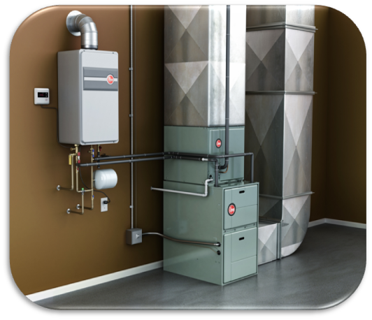
Rheem Market Position
Rheem manufactures high-quality tank, tankless, solar, hybrid and integrated air and water heating solutions. Rheem is unique!
Tank
Rheem
AO Smith
Bradford
Tankless
Rheem
Rinnai
Noritz
Takagi
Bosch
Solar
Rheem
AO Smith
Bradford
Sun Earth
Heliodyne
AET
Integrated Air & Water Heating Exclusive Offering Only From Rheem
Hybrid
Rheem
AO Smith
GE
8
Notes:
We manufacture and sell all the leading water heating technologies… no other manufacture can make that statement. We sell the energy efficient products your customers demand.

Slide 9
Rheem Advantage The Trusted Line of Residential Products
Best known brand
Full product lines & parts
Enhanced-flow brass drain valves
Best FVIR solution, maintenance free
Stainless steel element(s)
All models low-lead compliant
Best quality, fewer call backs
Largest line of ENERGY STAR® water heaters
New Pr fessional Product Line
9

Slide 10
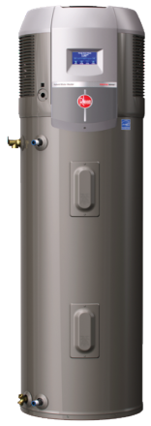
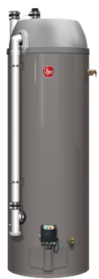
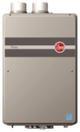
New Professional Product Line The Time Is Right for Investment
INVESTMENT IN OUR PRODUCTS
INVESTMENT IN OUR WHOLESALERS
INVESTMENT IN OUR PLUMBERS
10

Slide 11
Introducing the Professional Line Exclusive Wholesale Products
Developed exclusively for the professional plumbers, delivering valuable product differentiation in their markets
11

Slide 12
The Professional Difference
Only offered through Rheem Wholesalers
Exclusive product features that professional plumbers and homeowners value
Three tiers of products – Classic, Classic Plus and Prestige
12

Slide 13
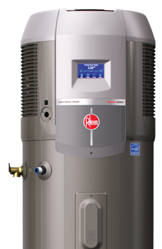
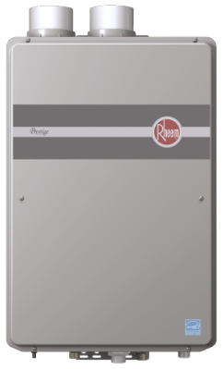
Three Professional Product Tiers
Prestige Series: First Tier
13

Slide 14
Three Professional Product Tiers
Classic Plus Series: Second Tier
14

Slide 15
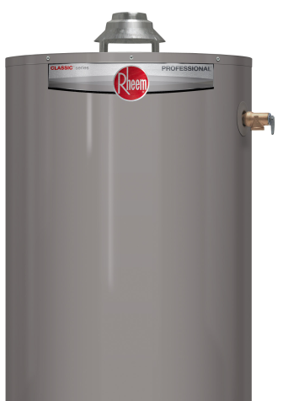
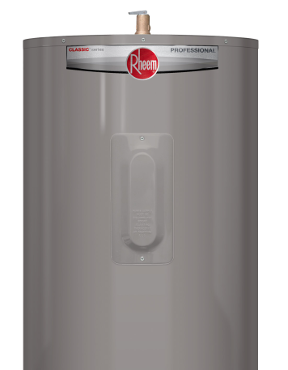
Three Professional Product Tiers
Classic Series: Third Tier
15

Slide 16
Phase I: Professional Series Features Tank-type Electric & Gas Models
Classic
Classic Plus
Prestige
Electric Models
V chassis
4500W copper & stainless elements
System Sentinel optional
30T, 40M, 40T, 50T, 50M
Enhanced flow Brass Drain Valve
Self cleaning
6/6/1 Warranty (10/6/1 with PPK)
Gas Models
30, 40, 50 V/VR/PV/PDV
Mechanical gas valve on atmospheric
Electronic GV on PV and PDV
Maintenance free FVIR
Enhanced flow BDV
Self cleaning
6/6/1 Warranty (10/6/1 with PPK)
Electric Models
VR chassis
4500W stainless & stainless elements
System Sentinel
40T, 50T, 65T, 80T, 50M
Enhanced flow BDV
Self cleaning
8/8/1Warranty (12/8/1 with PPK)
Gas Models
Energy Star Power Dampered (PD)
Energy Star Induced draft (XR90)
High input V, PV and PDV
EGC on PD, PV and PDV
Maintenance free FVIR
Enhanced flow BDV
Self cleaning
8/8/1 Warranty (12/8/1 with PPK)
Electric Models
Hybrid Heat Pump
Energy Star rated
2.45 EF
8700 Btu compressor, best in class
Full-color LCD display
Stainless elements top and bottom
Enhanced flow BDV
12/12/1 Warranty (Hybrid)
Gas Models
PDV Condensing Storage
Energy Star rated
.82 EF, best in class
EGC with diagnostics
FHD & recovery, best in class
28% reduction in operating cost
Enhanced flow BDV
6/6/1 Warranty
16

Slide 17
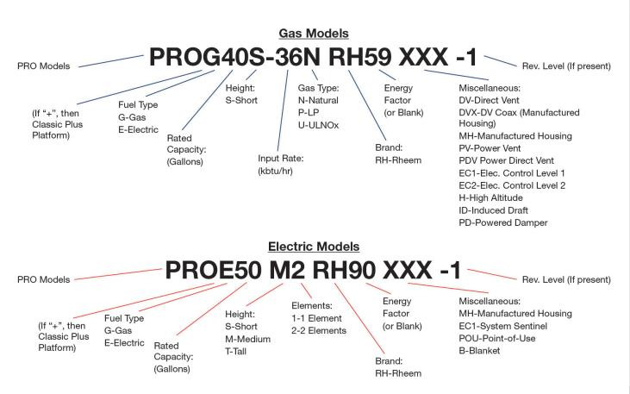
New Professional Model Numbers
More Intuitive for Easy Replacements
Online Conversion Tool: Rheem.com/CrossReference
17

Slide 18
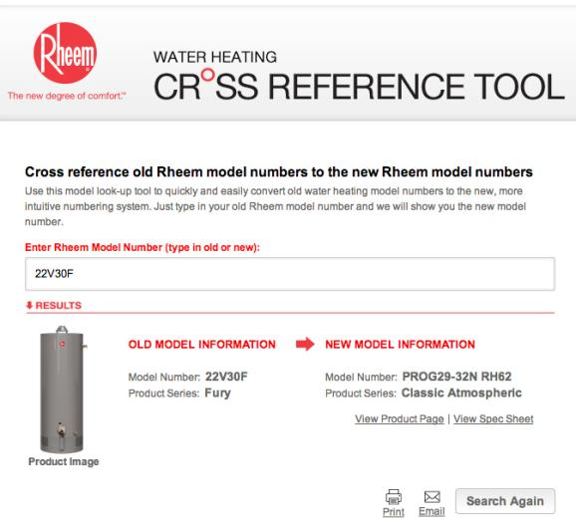
Model Number Cross Reference Tool
Convert New to Old... or Old to New
http://www.rheem.com/products/tank_water_heaters/crossreference/
18

Slide 19
All-New ProClub Rewards Program
Contractors Earn More Bonus Points Faster
Increased point values, more products qualify!
All Prestige and Classic Plus products qualify
Popular commercial products now qualify
Lead referral program...
Easy consumer access to Preferred Plumbers on Rheem.com
More qualified leads delivered to plumbers
ProClub promos in every carton
Points can be redeemed for valuable business tools, gifts, and gift cards
Visit MyRheem.com/ProClub
19

Slide 20
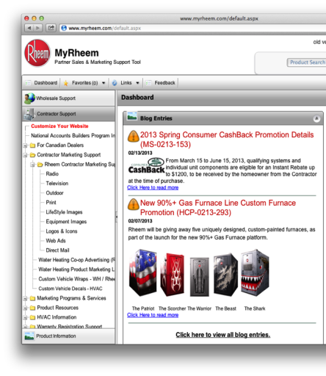
MyRheem.com
Revamped Customer Portal
The MyRheem.com portal is customized for plumbers
Plumber-specific content
Training videos
Marketing support programs
24/7 availability
One source for product information, marketing tools and product training
http://myrheem.com/
20

Slide 21
ENERGY STAR Qualified Tank-Type Models
New minimum Energy Factor requirement for tank water heaters is .67 or greater. Rheem offers a full selection of ENERGY STAR® tank water heaters.
Dampered Atmospheric-GAS (.67 EF or greater)
Model | Comments | Availability
PRO+G38-40N RH69 PD* | Tall | Now
PRO+G40S-40N RH67 PD* | Short | Now
PRO+G50-40N RH67 PD* | Tall | Now
PRO+G50S-40N RH67 PD* | Short | Now
PRO+G50-50N RH67 PD | Tall Hi-Input | Now
PRO+G40-36U RH68 | Ultra Low NOx | Now
PRO+G50-36U RH68 | Ultra Low NOx | Now
Power Vent-GAS (.67 EF or greater)
Model | Comments | Availability
PROG40-40N RH67 PV* | Tall | Now
PROG40S-36N RH67 PV* | Short | Now
PROG50-42N RH67 PV* | Tall | Now
PROG50S-36N RH67 PV* | Short | Now
PROG40-36U RH67 PV | Ultra Low NOx | Now
PROG50-38U RH67 PV | Ultra Low NOx | Now
Condensing Power Direct Vent-GAS (.82 EF)
Model | Comments | Availability
RHE40S* | 38 gal | Now
RHE50* | 48 gal | Now
Induced Draft Atmospheric-GAS (.70 EF)
Model | Comments | Availability
PRO+G29-60N RH70 ID | Tall | Now
Hybrid Heat Pump-ELECTRIC (2.45 EF)
Model | Comments | Availability
HB50RH | 50 gal | Now
Power Vent & PDV-GAS (94% Thermal EF or greater)
Model | Comments | Availability
GHE80ES-130(A)* | Ultra Low NOx | Now
GHE80ES-150(A)* | Ultra Low NOx | Now
GHE80ES-200(A)* | Ultra Low NOx | Now
GHE100ES-130(A)* | Ultra Low NOx | Now
GHE100ES-160(A)* | Ultra Low NOx | Now
GHE100ES-200(A)* | Ultra Low NOx | Now
Power Direct Vent-GAS (.67 EF or greater)
Model | Comments | Availability
PROG40-40N RH67 PDV* | Tall | Now
PROG50-40N RH67 PDV* | Tall | Now
Note: Rheem hybrid electric heat pump, Rheem Condensing PDV, Rheem tankless gas models, and Rheem solar water heating systems qualify for federal energy tax credits (when available) and many other state and local rebates/incentives.
All gas models are available in Natural Gas. Those with asterisks (*) are also available in liquid propane (LP) models.
21
Notes:
Rheem offers the most ENERGY STAR Phase II tank models!

Slide 22
Residential Tank Warranties
Warranties Product Family
6 or 10 Years Classic™ 6 Years 10 Years with ProtectionPlus™ Kit DVs & PDVs (see spec sheets for warranty details)
8 or 12 Years Classic Plus™ 8 Years 12 Years with ProtectionPlus™ Kit
Up to12 Years Prestige™ Hybrid (12), Tankless (12), Condensing PDV (6)
Lifetime Marathon™ Electric
22

Slide 23
ProtectionPlus™ Warranty Extension Kit
Best water heater warranty in the industry comes in the smallest box!
Small box doubles your product offering, without doubling your tank inventory
ProtectionPlus™ kit includes heavy duty, resistored magnesium anode rod with plastic lined nipple (hot side)
23

Slide 24
Classic Plus Electric & Gas Features
Higher efficiency: Reduces annual operating cost. Ask about ENERGY STAR models.
Better warranty: 8 Year tank and parts
Upgradeable: Up to 12 year tank warranty with ProtectionPlus™ kit
Larger anode: 65% more volume than 6 year models
Increased labor allowance: Benefits contractors’ bottom line
ProClub: Fully funded Rheem loyalty program, provides contractors with sales incentives/rewards
24

Slide 25
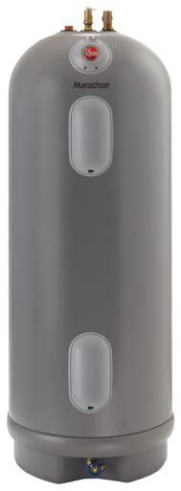
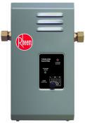
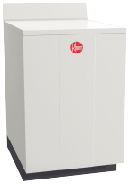
Rheem Electric Product Line
25

Slide 26
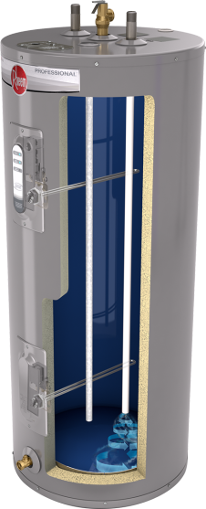
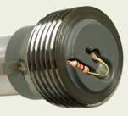
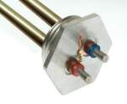
The Rheem Electric Advantage Superior Tank and Element Protection
Stainless Steel Element(s)
For longer life (lower element on Classic/both on Classic Plus)
Enhanced-flow Brass Drain Valve
Drains tank in half the time
System Sentinel diagnostics
Available on all Classic Plus and some Classic models
EverKleen™
Self-cleaning device removes sediment
R-Tech Tank Protection System
Exclusive! Resistored anode technology controls rate of anode depletion
System matching resistored elements, extends element life
Offers superior tank protection
Longer tank and component life
…only from Rheem
26

Slide 27
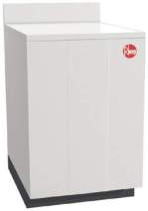
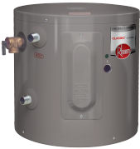
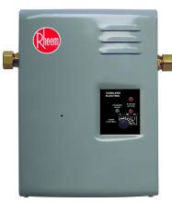
Rheem Electric Product Line
Marathon LIFETIME warranty (High temp, heavy duty models have 10 year warranties)
Prestige Hybrid 12 Year warranty ENERGY STAR®
Classic Plus 8 Year warranty (12 Years with ProtectionPlus kit)
Classic 6 Year warranty (10 Years with ProtectionPlus kit)
Table-top 6 Year warranty
Point of Use (POU): 2.5-30 gal tanks and new electric tankless
Classic Manufactured Housing 6 Year warranty
27

Slide 28
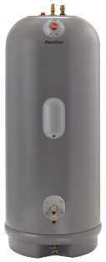
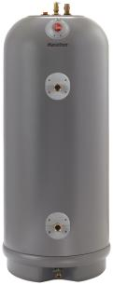
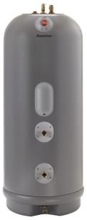
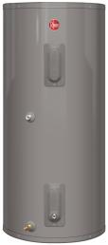
Rheem Electric Product Line (cont.) Special Application Tanks
Solaraide-HE 6 Year warranty
Solaraide 6 Year warranty
Marathon Thermal Storage Limited lifetime warranty
28

Slide 29
Professional Prestige™ Series Hybrid
2.45 EF – Reduces annual operating cost
8700 BTU/h compressor
Full-color touch screen control Five operating modes:
1. Energy Saver
2. Heat Pump Only
3. High Demand
4. Electric Heat Only
5. Vacation: 2-28 days or on hold indefinitely
Service diagnostics/warning alarms
50 Gallon Capacity
240 Volt – 1 PH, max. draw 24 amps
Ambient air operating range: 37-120ºF
WiFi enabled
Easy installation – Narrow 21” diameter fits through access doors, installs like standard electric
Washable air filter: Easy access, top mounted
Patented magnesium anode rod
¾” NPT water inlet, outlet and condensate drain connections
Incoloy stainless steel resistored heating elements; dry fire protection
Enhanced-flow brass drain valve and T&P valve
12-Year limited warranty tank & parts
Earn ProClub points with Prestige products
Prestige Hybrid HB50 12 Year warranty ENERGY STAR®
29

Slide 30
Professional Classic Plus™
EF range of 0.92 to 0.95
Enhanced-flow brass drain valve reduces drain time 50%
System Sentinel (glowing LEDs verify element operation)
40, 50, 65, and 80 gallon capacities
Medium and tall configurations
Stainless steel upper and lower elements for longer life
EverKleen™ self-cleaning device fights sediment build up
8 Year tank and parts warranty
Protection Plus™ upgrade to 12 year warranty available
Standard 240V/208V, 4500 W/3375 W
Earn ProClub points with Classic Plus products
30

Slide 31
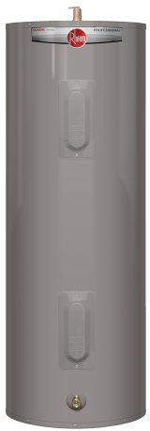
Professional Classic™ Electric
EF range of 0.85 to 0.95
Enhanced-flow brass drain valve reduces drain time 50%
30, 40, 47, 50, 65, 80 and 119 gallon capacities
Short, medium, and tall configurations
Double element configurations/lower element stainless steel
System Sentinel option available on some models
6 Year warranty when professionally installed
Protection Plus™ upgrade to 10 year warranty available
Standard 240V/208V, 4500 W/3375 W
31

Slide 32
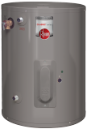
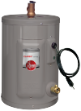
Professional Classic™ POU Electric
EF 0.93 for 30 gallon model
Enhanced-flow brass drain valve reduces drain time 50%
2.5, 6, 10, 15, 19.9 and 30-gallon capacities
Single resistored stainless steel element
Wall bracket for easy wall-mount installations
Standard 6 year warranty
Standard 120V, 2000 W
Gallon capacity of 2.5, 6, 10 and 19.9 do not require EF testing.
32

Slide 33
Rheem Marathon™ Electric
EF range of 0.90 to 0.94
40, 50, 85, and 105-gallon capacities
Limited Lifetime warranty! (heavy duty models for 170-175º temperature applications, 10 years)
Long lasting polybutene inner tank
Tough polyethylene jacket
Standard non-simultaneous element wiring
Standard 240V
Titanium lower element, 3kW, 3.8kW, or 4.5kW
Lightweight, no anode rod required!
Earn ProClub points with Marathon
33

Slide 34
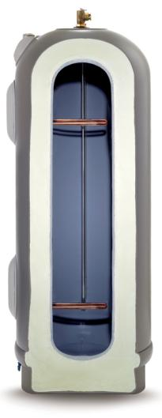
Hot Water for Life!
Temperature and pressure relief valve
All-plastic tank
Fill tube
Thermally fused upper heating elements
Tough molded polyethylene outer jacket
2 ½” Energy efficient insulation
Long-lasting titanium lower element
Recessed brass drain valve
LIFETIME Limited Tank Warranty
Non-metallic design eliminates chemical interactions with sulfates that are common in well water
Tough blow-molded plastic tank and outer shell withstands the harshest envionments
One of the highest energy factors
Tough blow-molded plastic tank and outer shell withstands the harshest environments
Tank is built to last “for as long as you own your home”
Easy to move, handle and install
34

Slide 35
Electric Point-of-Use and Table Top
Rheem Classic POU
2.5, 6, 10, 15, 19.9 and 30-gallon capacities
120V standard with 240V available
Single phase
Electric Tankless POU
3.2 KW, 120 Volt
7, 9, 13, 18, 27 KW, 240 Volt
Marathon POU
15 and 20-gallon product
Standard 120V, with some 240V
Table Top
40 Gallon
240V, 4500 watt
35

Slide 36
Rheem Prestige™ Series Hybrid 2.45 Energy Factor
WATER HEATING PRODUCTS
Notes:
Need ordering information? Please call Rheem Customer Service after April 9, 2013.

Slide 37
Professional Prestige™ Series Hybrid Integrated Heat Pump Technology
Introducing the Next Generation Rheem Prestige Series Hybrid Water Heater The newly designed hybrid offers the latest features:
2.45 EF: Provides homeowners with real energy savings
8700 Btu/h Compressor: Most powerful in its class – means less dependence on traditional element heat year round
Backlit LCD Display: Full-color, touch screen with intuitive adjustments and service diagnostics – operate it in the dark!
Widest Ambient Operating Range for a Heat Pump: 37-120 degrees; HP compressor can be used more days out of the year in cooler climates
Interconnectivity Enabled: EcoNet™ compatible for future integration with home automation, energy management and demand response systems
37

Slide 38
Professional Prestige™ Series Hybrid Energy Efficiency & Fuel Savings
Energy Efficiency
• 2.45 Energy Factor
• ENERGY STAR® rated
• Average yearly operating cost is $215 – less than $18 per month!
Earn ProClub points!
38

Slide 39
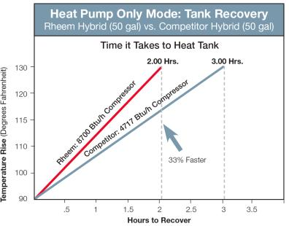
Professional Prestige™ Series Hybrid Performance
Powerful Performance
8700 Btu/h compressor: the most powerful in its class – more water is heated by the heat pump and less by traditional elements
Ambient Operating range: 37-120° F is widest in its class… more days of HP operation in cooler regions annually
Designed to meet Northern Climate Spec (Tier 1)
Heat Pump Only Test
This test Illustrates the true value of a 8700 Btu/h Heat Pump compressor. The three hour temperature rise test is closer to a real-life example of how the Rheem hybrid reduces fuel costs and speeds hot water recovery.
39

Slide 40
Rheem Prestige™ Hybrid Overview
2.45 Energy Factor
ENERGY STAR® rated
2.45 Energy Factor
8700 Btu/h compressor: most powerful in its class – more water is heated by the heat pump and less by traditional elements
Ambient Operating range: 37-120° F is widest in its class
21” diameter fits through access doors
Easily replaces a standard electric water heater
Backlit LCD controls and diagnostics
240v / Single phase / 24 AMPS
Keep unit upright during transportation and installation
Select the right installation site - Install indoors, ambient temp 37-120 degrees (i.e. basements, attics & garages)
40

Slide 41
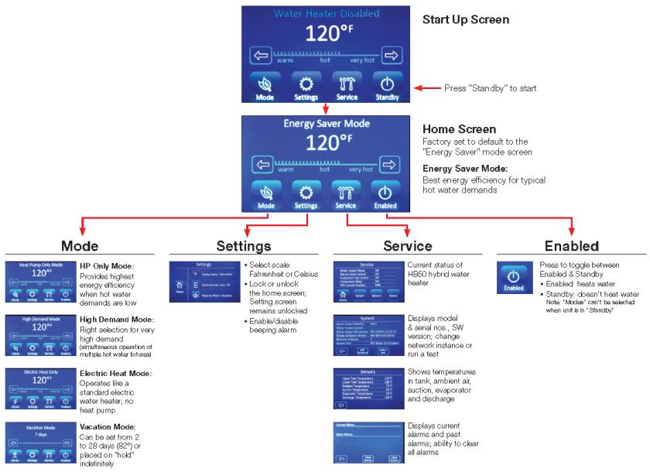
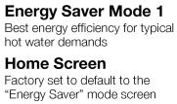
Intuitive LCD Display Back Lit, Full Color, Touch Screen Controls
Button toggles between Standby & Enabled
41

Slide 42
Rheem Prestige™ Series Hybrid FABs Competitive Features, Advantages & Benefits
Feature | Advantage | Homeowner Benefit | Contractor Benefit | Wholesaler Benefit
2.45 EF | High efficiency | Significantly lowers homeowner’s energy bills | Lower operating cost makes it easier to up sell | Competitive advantage
8700 Btu/h compressor | Most powerful compressor in its class, highest Btu; heats water much faster in HP-only mode; less reliance on electric elements | Greater energy efficiency in real-life applications; lower energy costs | Increased reliability, built to work longer and harder | Competitive advantage
Intuitive, full-color, back lit, LCD display | Intuitive operation and the only full-color, back lit, touch screen that can be operated in a dark basement or attic | Easy-to-adjust water temperature. Five operating modes for top efficiency. & comfort | Speeds installation & maintenance with intuitive diagnostics, scrollable history and alarms (system alerts) | Competitive advantage
Sleek, contemporary design | Elegant, high tech design instills confidence | Homeowner product satisfaction increased | Easier to up sell an attractive water heater; more sales | Competitive advantage
Narrow diameter | Easier installation in tight spots | Takes up less floor space | Fits through tight access doors for more application flexibility | Competitive advantage
Ambient temp operating range: 37-120 degrees | Widest operating temp. range in its class, able to operate in lower temperatures (cooler climates) | Lowers energy costs by operating Heat Pump more days per year | Can be installed in more geographic areas. Designed to meet Northern climate spec (Tier 1) | Competitive advantage
R410A Refrigerant | Considered to be a more eco-friendly choice over R134A, only Rheem Hybrid has it | A "greener" feel-good product choice. | Required by new Federal laws for HVAC equipment, R410A is now a commonly available refrigerant that contractors know and respect | Competitive advantage
Interconnectivity enabled | Built for future communication capabilities with EcoNet | Easily upgraded with future software updates & features | Plan to offer future remote diagnostics & control features | Competitive advantage
ENERGY STAR rated, plus fed. tax credits | ES designation insures energy efficiency | Increases homeowner's confidence and qualifies for many rebates/ incentives | Easier up sell with ES label | Competitive advantage
42

Slide 43
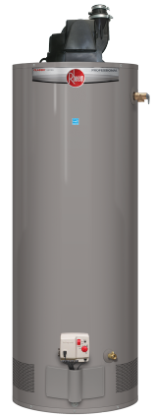
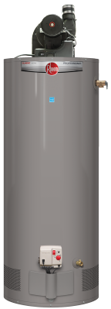
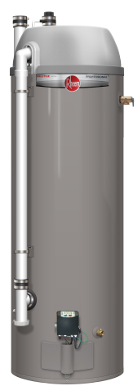
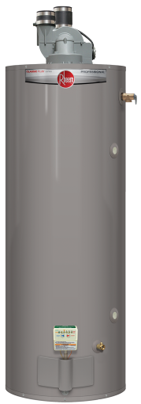
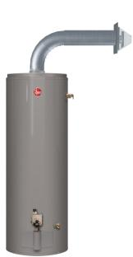
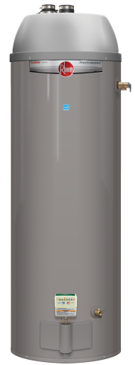
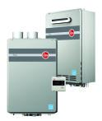
Rheem Gas Product Line
43

Slide 44
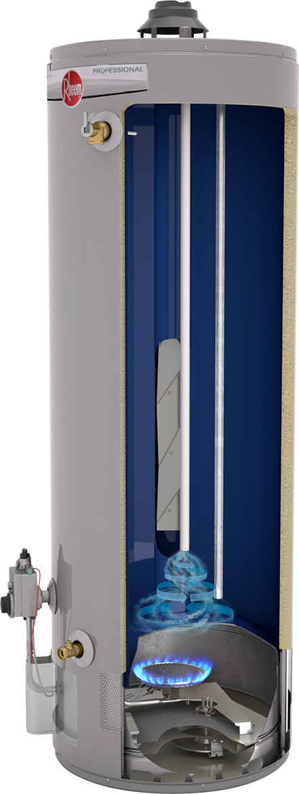
The Rheem Gas Advantage Superior Tank, FVIR Protection, ENERGY STAR Line Up
Enhanced-Flow Brass Drain Valve
Enhanced flow drains the tank in half the time!
EverKleen™
Self-cleaning device removes sediment
Tank Protection System
Premium grade anode rod controls rate of anode depletion
Offers superior tank protection
Longer tank and component life
Superior Design! Flammable Vapor Ignition Resistance (FVIR)
Largest ENERGY STAR Line Up …only from Rheem
44

Slide 45
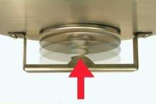
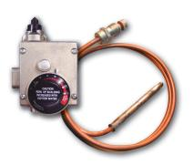
Rheem Guardian System™ FVIR Flammable Vapor Ignition Resistance
Exclusive Air Shut-off System Provides Double Protection
Standard Parts
Maintenance Free No filters to clean, nothing to reset…
45

Slide 46
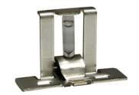
The Rheem FVIR Advantage Unrivaled Flammable Vapor Ignition Resistance Design
The Right FVIR Solution
The Best FVIR Solution
Flammable Vapor
Auto Shut Off!
46
Notes:
During FVIR implementation, we introduced you to the basic principles of the spill test and the use of arrestor plate technology to contain burner vapors.
We also demonstrated Rheem Guardian system’s exclusive air & fuel shutdown system that offers double protection.

Slide 47
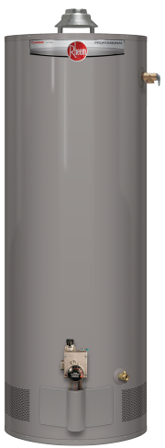
Rheem Gas Storage Tank Product Line
FVIR Compliant: Atmospheric Vent, Dampered Vent, PV, PDV, Condensing PDV, DV, and Fan Assisted Draft Induced
Classic Atmospheric Tall & Short Ultra Low NOx Models Available
Classic Plus Dampered Ultra Low NOx Models Available
Classic Power Vent Tall Model
Ultra Low NOx Models Available
Classic Power Vent Short Model
Ultra Low NOx Models Available
Prestige Condensing Power Direct Vent Tall & Short Models
Classic Power Direct Vent Tall & Short Models
Classic Vertical Direct Vent
Classic Horizontal Direct Vent
Classic Plus Fan Assisted Draft Induced Tall Model
47

Slide 48
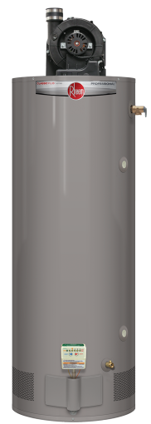
Gas Storage Tank Product Line (cont.)
Heavy Duty - High Recovery - FVIR Compliant Large Capacity and High Input
Classic Plus Atmospheric Heavy Duty
Classic Plus Power Vent
Heavy Duty
Classic Plus Non-Domed Power Direct Vent
Heavy Duty
Classic Plus Ultra Low NOx Atmospheric Heavy Duty
48

Slide 49
Gas Storage Tank Product Line (cont.)
Manufactured Housing Models
Classic/FVIR Atmospheric Vent
Classic
Direct Vent
Classic Direct Vent (DVX/coaxial)
49

Slide 50
New Introduction High-Efficiency Condensing Prestige™ Power Direct Vent
Residential Water Heating
Record Setting .82 EF!
ENERGY STAR Rated
Qualifies for Federal Tax Credits

Slide 51
Prestige™ Condensing Power Direct Vent New! High Efficiency Models
Leading 0.82 EF exceeds Phase II ENERGY STAR rating!
48-Gallon tall models
Input: 40,000 Btu/h
Recovery: 48.5 GPH 90 degree rise
First hour delivery: 93 GPH
38-Gallon short models
Input: 40,000 Btu/h
Recovery: 48.5 GPH 90 degree rise
First hour delivery: 74 GPH
Perfect choice when energy efficiency, indoor air quality or tight construction are concerns
Natural gas and LP
Venting: 2 and 3 inch diameter PVC, CPVC, or ABS
60 feet equivalent venting with 3 inch diameter pipe
Certified to 9,000 ft. above sea level
All models are 40ng/J NOx and Guardian™ FVIR
6-Year warranty
All models certified with optional 3 inch concentric vent kit
New!
PDV with .82 EF
LEED Points=2
51

Slide 52
Prestige™ Condensing Power Direct Vent High Efficiency Condensing Technology
High Efficiency Condensing Technology… with Record Setting .82 EF Energy Savings!
RHE targets the real concerns of homeowners: Energy efficiency and indoor air quality
Five coil submerged heat exchanger increase heat transfer and efficiency
Heat exchanger is porcelain coated inside and out and for long life
Dual patented magnesium anode rods with resistors to protect tank from corrosion
Integrated diagnostic system for easy installation, operation and service
ENERGY STAR rated
Average operating cost less than $17 per month!
Self-Diagnostic System
PDV with .82 EF
RHE40S Short &
RHE50 Tall Models
52

Slide 53
Prestige™ Condensing Power Direct Vent Anatomy of High Efficiency Condensing PDV
Air intake
Exhaust
Quality Construction, Easy Installation, Low Cost-to-Own!
Schedule 40 PVC Venting
New!
PDV with .82 EF
Built-in Exhaust Riser
Heat exchanger porcelain coated inside and out
Dual patented magnesium anode rods
Five coil submerged heat exchanger
Enhanced-flow Brass Drain Valve drains tank in half the time
Integrated diagnostic system
PLUS…
Durable silicon nitride igniter
Everkleen™ device removes sediment
Uses standard replacement parts
53

Slide 54
Classic Plus™ Heavy Duty Gas Atmospheric Vent
.49-.58 Energy Factor
8-Year warranty/ 12 years with ProtectionPlus™ Kit
Enhanced-flow brass drain valve
Higher Btu/h inputs than standard (>40,000 Btu/h)
Side water connections for space heating
Side connections: 48, 63, 75, and 98-gallon tall models
60 Gallon tall model/without side connections
Natural and LP fuel types
Models are 40ng/J NOx and FVIR compliant
Side water
connections for space heating
54

Slide 55
Classic Plus™ Powered Damper
Energy Efficient Damper Design
.67-.69 Energy Factor
24 VAC flue damper w/ power cord included
Installs with standard Cat. I B vent
8-Year warranty/ 12 years with ProtectionPlus™ Kit
Enhanced-flow brass drain valve
EverKleen system fights sediment build up
38 & 50 gallon tall models
40 and 50 gallon short models
50 gallon-50k Btu/h model
Models are 40ng/J NOx and FVIR compliant
Technology Note: Damper closes when combustion process ends to retain more heat and opens when combustion begins again
55

Slide 56
Classic Plus Induced Draft
WATER HEATING PRODUCTS
29 Gallon – 60,000 BTU Natural Gas Water Heater
56
Notes:
Rheem’s newest high efficiency residential gas water heater.

Slide 57
Induced Draft: Key Benefits Compact size, more hot water, lower operating cost
Low operating cost: High .70 EF, easy up sell
Small size: Compact 29 gallon size fits when others won’t
More hot water faster: Exceeds standard 50 gallon performance
Fast one-man installation: Compact and light weight… ideal retrofit!
Low emissions: Low NOx burner design (60,000 Btu/h)
Self-diagnostic system: Easier installation, faster service
57
Notes:
The induced draft water heater is the ideal choice when replacing 40 or 50 gallon models located in attics and other tight spaces.

Slide 58
Induced Draft: Key Features Compact size, more hot water, lower operating cost
.70 EF: Exceeds ENERGY STAR Phase II requirement
Compact 29 gallon model with 90 gallon FHR performance: Exceeds standard 50 gallon model by 10%
Recovery rate of 61 GPH at 90 degree rise: Exceeds standard 50 gallon by 51%!
60,000 Btu/h: Low NOx burner design
Fan assisted draft: Propels the cooler flue gases up the vent
110 VAC draft inducer: Includes 8 ft. cord & plug
Standard venting: Category I, double wall, B-vent
Well insulated: Reduces stand-by heat loss
(Continued)
58
Notes:
Packed with a 90 gallon FHR, recovery greater than a standard 50 gallon gas, and an energy saving .70 EF, the induced draft model offers an annual operating cost of just $233.00/year or less than $20 per month!

Slide 59
Induced Draft: Key Features (cont.) Compact size, more hot water, lower operating cost
Integrated self-diagnostic Honeywell gas valve: Speeds installation and service
Guardian FVIR System: Maintenance free, no filter to clean
Flammable Vapor Detection Sensor: Protective control system that disables the heater in the presence of flammable vapor accumulation
Longer life tank: Patented magnesium anode rod design with special resistor protects the tank from corrosion
High altitude compliant: Certified up to 10,100 ft (above sea level) (Continued)
59
Notes:
The induced draft model has the lowest operating cost of any Rheem gas water heater, yet outperforms a standard 50 gallon gas model!

Slide 60
Induced Draft: Key Features (cont.) Compact size, more hot water, lower operating cost
Enhanced-flow brass drain valve: Standard
T & P relief valve: Standard
Meets 40ng/J NOx requirement
8-Year warranty: Upgradable to 12 years with ProtectionPlus™ kit
Therm-X-Guard thermal expansion tank is recommended
60
Notes:
Natural gas only.

Slide 61
Induced Draft
Close Up of Fan Assist Draft Inducer (FADI)
Front and Right Side of FADI
Front and Left Side of FADI
61
Notes:
Close up view of the induced draft.

Slide 62
Why is a Fan Assist Draft Inducer Needed?
Standard gas water heaters produce extremely hot air during combustion, which moves the combustion gases quickly up the chimney
The induced draft model is much more efficient (i.e. it puts more heat in the water and less heat up the chimney)
A proprietary baffle and flue design retains the heat longer, therefore a device is needed to propel the air and gases upward
Fan assist draft inducer creates the proper draft to expel the combustion gases
62
Notes:
Category I, B-vent only. This product cannot be vented with any other material. Fan assist induced draft products should be vented vertically. They cannot be vented horizontally.

Slide 63
Rheem XR 90
Performance Charts
Induced
Draft
Induced
Draft
Standard 40k Btu
Gallons
Gallons
Standard 40k Btu
29 Gal
50 Gal
29 Gal
50 Gal
Gallon Capacity of Water Heater
Gallon Capacity of Water Heater
63
Notes:
This powerful 29 gallon water heater out performs a 50 gallon in both FHR and Recovery.

Slide 64
Classic Plus Induced Draft
Energy Efficiency
Induced
Draft
Standard 40k Btu
Energy Factor (EF)
29 Gal
50 Gal
Gallon Capacity of Water Heater
Calculation of Energy Factor based on FTC Energy Guide labels
64
Notes:
Plus it is more efficient and that translates into real savings for the homeowner.

Slide 65
Classic Plus Induced Draft Spec Summary
29 Gallon Tall Model
.70 EF Exceeds Phase II ENERGY STAR requirements
50 Gallon performance in a 29 gallon package!
60,000 Btu/h
Natural gas
3” or 4” diameter Category I, double wall, B-vent
110V (includes 8 ft. power cord with 3 prong plug)
Self diagnostic Honeywell gas valve
Certified to 10,100 ft. above sea level
All models are 40ng/J Nox and FVIR compliant (Continued)
Induced Draft: PRO+G29-60N RH70 ID
90 Gallon FHR
.70 Energy Factor
65
Notes:
induced draft models are atmospheric natural gas water heaters. Category I, B vent is required. The fan assist induced draft assembly is not a blower and does not extend venting nor does it allow horizontal venting. In order to achieve the .70 EF, baffle restriction is required. This restriction requires a fan assist draft device to draw flue gases to the chimney. The Honeywell gas valve is specific to this particular model as the control algorithm has been modified.

Slide 66
Spec Summary (cont.)
17-3/4” Diameter
65-1/2” Overall Height
Rated capacity – 29 gallons
60,000 Btu/h
ProtectionPlus™ warranty upgrade available
Utilizes current Guardian FVIR platform
Flammable Vapor Detection Sensor
Arrestor plate technology
TRD activated Air Shut-off
Flammable vapor detection sensor
Spark to pilot
Flammable Vapor Sensor
66

Slide 67
Classic Plus Induced Draft Installation
Standard ¾” top connect inlet/outlet
Therm-X-Guard thermal expansion tank is recommended due to the high recovery
110V power source, 8’ power cord included
FV Sensor FVIR design
Self-Diagnostic Honeywell gas valve
Category I, double walled B-vent 3” or 4”
Factory supplied 4” adaptor included
Vertical venting only
67
Notes:
Installation of the induced draft model is comparable to any other atmospheric product. Cold inlet, hot outlet, T&P, gas connection, Category I B-vent (single or double wall), thermal expansion device (recommended). The only difference being the 110V requirement within reach of the 8’ power cord and three prong plug, which is supplied. To ensure the correct gas valve is used, the temperature control knob is blue.

Slide 68
Questions?
Classic Plus Induced Draft
Residential Fan Assist Draft Induced Natural Gas Water Heater
Earn ProClub Points!
Compact – Energy Efficient – Powerful
sales@rheem.com 800-621-5622
68

Slide 69
Classic™ Gas Atmospheric Vent
.58-.62 Energy Factor
6-Year warranty/ 10 years with ProtectionPlus™ Kit
Enhanced-flow brass drain valve
EverKleen system fights sediment build up
29, 38, 40, and 50-gallon tall models, with .62 EFs on 29, 40 and 50-gallon models
30, 40, and 50-gallon short models, with .62 EF on the 40-gallon model
Natural and LP fuel types
Models are 40ng/J NOx and FVIR compliant
69

Slide 70
Classic™ Direct Vent - Horizontal
.59 Energy Factor
6-Year warranty/ 10 years with ProtectionPlus™ Kit
Enhanced-flow brass drain valve
EverKleen system fights sediment build up
40 and 50-gallon tall models
Natural and LP fuel types
Adjustable horizontal coaxial vent (sold with heater)
Optional 4ft. vertical or horizontal vent kits available
All models are 40ng/J NOx and FVIR compliant
70

Slide 71
Classic™ Direct Vent
.59 Energy Factor
6-Year warranty/ 10 years with ProtectionPlus™ Kit
Enhanced-flow brass drain valve reduces drain time 50%
EverKleen system fights sediment build up
40 and 50-gallon tall models
Natural and LP fuel types
Adjustable vertical coaxial vent (sold separately)
5 Adjustable lengths available 24” – 160”
34 or 42 degree max pitch roof jacks available
All models are 40ng/J NOx
71

Slide 72
Classic™ Power Vent Products
40 and 50 Gallon tall and short models
Enhanced-flow brass drain valve cuts drain time 50%
Utilizes current Guardian FVIR platform
Flammable Vapor Detection Sensor
Arrestor plate technology
TRD activated Air Shut-off
ProtectionPlus™ warranty upgrade available
Flammable Vapor Sensor
72
Notes:
In addition to the Guardian Systems combustion chamber, we added a flammable vapor detection sensor.
The sensor is attached to the water heater’s jacket & located just under the outer door.
It is wired into the power vent’s gas control.

Slide 73
Classic™ Power Vent (cont.)
.67 Energy Factor
6-Year warranty/ 10 years with ProtectionPlus™ Kit
Enhanced-flow brass drain valve
EverKleen system fights sediment build up
40 and 50 Gallon/tall and short models
Self-diagnostic system
Natural and LP fuel types
Vent up to 100 feet equivalent
High altitude compliant
Use 2” or 3” PVC, CPVC, or ABS vent
All models are 40ng/J NOx and FVIR compliant
73

Slide 74
Classic Plus™ Heavy Duty Power Vent
.59-.62 Energy Factor
6-Year warranty/10 years with ProtectionPlus™ Kit
Enhanced-flow brass drain valve
EverKleen system fights sediment build up
60 and 75-gallon tall models
Higher Btu/h inputs, greater than 40,000 Btu/h
Natural and LP fuel types
Vent up to 100 feet equivalent
Side connections on 75-gallon models
Use 3” or 4” PVC, CPVC, or ABS vent
All models are 40ng/J NOx and FVIR compliant
74

Slide 75
Classic Plus™ Heavy Duty
Power Direct Vent
.62 Energy Factor
8-Year warranty/12 years with ProtectionPlus™ Kit
Enhanced-flow brass drain valve
EverKleen system fights sediment build up
50, 65 and 75-gallon tall models
Higher Btu/h inputs, greater than 40,000 Btu/h
Natural and LP fuel types
Vent up to 100 feet equivalent
Side connections on 75-gallon model
Use 3” or 4” PVC, CPVC, or ABS vent
All models are 40ng/J NOx and FVIR compliant
75

Slide 76
Classic™ Power Direct Vent
.67 Energy Factor
6-Year warranty/10 years with ProtectionPlus™ Kit
Enhanced-flow brass drain valve
EverKleen system fights sediment build up
40 and 50-gallon tall models
Self-diagnostic system
Natural and LP fuel types
Certified to 10,200 ft. above sea level
Vent up to 100 feet equivalent
Use 2” or 3” PVC, CPVC, or ABS vent
All models are 40ng/J NOx and FVIR compliant
All models certified with optional 3” concentric vent kit
76

Slide 77
Classic™ Power Direct Vent (cont.)
Combustion Exhaust
Air Inlet
“2-Pipe System”
Combustion make-up air piped from outside
Combustion exhaust piped to outside
Perfect for Special Requirements
Negative air pressure applications
Tight construction
Air quality issues
77

Slide 78
Classic™ Manufactured Housing
.58-.61 Energy Factor
30, 40 and 50-Gallon atmospheric vent and direct vent models
40 and 50-Gallon Coaxial DVX models
EverKleenTM system fights sediment build up
Field convertible between natural and LP fuels
6 Year warranty
Classic/FVIR Atmospheric Vent
Classic
Direct Vent
Classic Direct Vent (DVX/coaxial)
78

Slide 79
Ultra Low NOx Gas Water Heater Line
Classic Plus Damper
Classic Plus Heavy Duty
Classic Atmospheric
Classic Power Vent

Slide 80
Classic Plus™ Ultra Low NOx Powered Damper
Energy Efficient Damper Design
Higher Energy Factors (0.68 EF)
24 VAC flue damper w/ power cord included
Installs with standard Cat. I B vent
8-Year warranty/12 years with ProtectionPlus™ Kit
Enhanced-flow brass drain valve
EverKleen system fights sediment build up
40 and 50 tall models
Natural gas only
Models are 10ng/J NOx and FVIR compliant
Technology Note: Damper closes when combustion process ends to retain more heat and opens when combustion begins again
Ultra Low NOx Burner Technology
80

Slide 81
Classic Plus™ Heavy Duty Ultra Low NOx
.56 Energy Factor
8-Year warranty/ 12 years with ProtectionPlus™ Kit
Enhanced-flow brass drain valve
Higher Btu/h inputs than standard (>40,000 Btu/h)
Side water connections for space heating
Side connections: 75 and 98-gallon models
Natural and LP fuel types
Models are 10ng/J NOx and FVIR compliant

Slide 82
Classic™ Ultra Low NOx Atmospheric Vent
.58-.62 Energy Factor
6-Year warranty/10 years with ProtectionPlus™ Kit
Enhanced-flow brass drain valve
EverKleen system fights sediment build up
28, 38, 40, 48, 50-gallon tall models
.62 EF: 28, 40 and 50-gal tall models
38-gallon short models
Natural gas only
Models are 10ng/J NOx and FVIR compliant
Ultra Low NOx Burner Technology
82

Slide 83
Classic™ Ultra Low NOx Power Vent
.67 Energy Factor
6-Year warranty/10 years with ProtectionPlus™ Kit
Enhanced-flow brass drain valve
EverKleen system fights sediment build up
40 and 50 Gallon tall models
Self-diagnostic system
Natural and LP fuel types
Vent up to 100 feet equivalent
High altitude compliant
Use 2” or 3” PVC, CPVC, or ABS vent
All models are 10ng/J NOx and FVIR compliant
83

Slide 84
Tankless Gas Water Heaters Key Features & Operating Costs
High-Efficiency Condensing
Mid-Efficiency
92 to 94% recovery efficiency
2” or 3” PVC venting
Integrated condensate neutralizer
$174-430 Annual operating cost
83-84% Recovery efficiency
3”/5” Concentric vent system
Integrated condensate collector
$199-482 Annual operating cost
2013 Estimated energy cost based on a national average fuel cost of $1.09/therm for natural gas and $2.41/gallon for LP. Energy factor determined by U.S. Department of Energy (DOE) test procedures.
84

Slide 85
Rheem Advantage The Trusted Line of Residential Products
Best known brand
Full product lines & parts
Enhanced-flow brass drain valves
Best FVIR solution
Stainless steel element(s)
All models low lead compliant
Best quality, fewer call backs
Largest line of ENERGY STAR® water heaters
New Pr fessional Product Line
85

Slide 86
Rheem Tankless Water Heaters Gas Models
WATER HEATING PRODUCTS
86
Notes:
Rheem’s newest high efficiency residential gas water heater.

Slide 87
Key Features & Operating Costs High- and Mid-Efficiency Models
High-Efficiency Condensing
Mid-Efficiency
94% Energy efficient
2” or 3” PVC venting
Integrated condensate neutralizer
$178-430 Annual operating cost
82% Energy efficient
3”/5” Concentric vent system
Integrated condensate collector
$199-482 Annual operating cost
87

Slide 88
New Tankless Products and Upgrades
Prestige™ RTGH high-efficiency condensing models
New design for RTG mid-efficiency models
Improved design and serviceability
Improved handling of installation variables
Installer friendly features
Remote connection on the bottom of unit
Gas pressure tap on inlet
2” or 3” PVC venting on RTGH Series
3”/5” Concentric venting on RTG Series
RTGH High-Efficiency Indoor and Outdoor Models
RTG Mid-Efficiency
Indoor and Outdoor Models

Slide 89
Inside High-Efficiency Condensing Units Prestige™ Indoor and Outdoor Models
Feature Packed…
Stainless steel secondary heat exchanger
All-copper primary heat exchanger
Over heat film wrap
Electronic spark ignition
11,000-199,900 Btu/h
Electronic control board
Condensate neutralizer
Variable speed fan
Water flow control system
Modulating gas valve
89

Slide 90
Features, Benefits & Warranties Available on All Tankless Gas Models
New Generation Burner - Natural Gas & LP
Modulating burner reduces fuel cost
Low NOx burner meets SCAQMD rule 1146 requirements
Exclusive! Guardian overheat film wrap
Activation and Flow Rates
Lowest activation and flow rates
0.26 GPM Minimum Flow
0.40 GPM Minimum Activation
Digital Controls
Remote control included
Displays temperature setting and maintenance codes
Intelligent electronic controls designed to increase energy efficiency and safety
Multiple Unit Installation Options
EZ-Link cable connects two units
Manifold connects 2 to 6 with optional MIC-6 control board
Link from 2 to 20 units with optional MIC-185 manifold control assembly
Other Features
High altitude capability, up to 9,840 feet above seal level
Optional commercial conversion kits (185º F)
Warranties
12 Year heat exchanger
5 Year parts
1 Year in-home labor
State, local, and utility rebates and incentives may be available in your area. Go to www.dsireusa.org for more information. LEED Points: 2

Slide 91
Prestige Series - RTGH High-Efficiency Condensing Tankless
Industry-Leading Features & Performance!
199,900 Btu/h with 9.5 GPM max flow
157,000 Btu/h with 8.4 GPM max flow
Indoor direct vent or outdoor models
Indoor models vent with 2” or 3” PVC
Up to 39 feet of 3” venting
Up to 94% Recovery efficiency
0.94 Energy Factor (EF)
0.26 GPM min flow rate
0.40 GPM activation flow rate
Integrated condensate neutralizer
Stainless steel secondary heat exchanger
Multi-unit capability
Commercial conversion kit option (185º F)
Warranty
12-Year Heat Exchanger,
5-Year Parts & 1-Year Labor
91

Slide 92
RTG
Mid-Efficiency Tankless
Industry-Leading Features & Performance!
199,900 Btu/h with 9.5 GPM max flow
180,000 Btu/h with 8.4 GPM max flow
150,000 Btu/h with 6.4 GPM max flow
Indoor direct vent or outdoor models
Indoor vents with 3”/5” concentric stainless
Fits Metal Fab Core Guard without adapter
Up to 84% Recovery efficiency
0.82 Energy Factor (EF)
0.26 GPM min flow rate
0.40 GPM activation flow rate
Multi-unit installation capability
Commercial conversion kit option (185º F)
Warranty
12-Year Heat Exchanger
5-Year Parts & 1-Year Labor
92

Slide 93
Venting Options and Installations
3”/5” Stainless Steel Vent Direct Vent for Non-Condensing Models
2” or 3” PVC Vent Direct Vent for Condensing Models
No Venting Materials for Non-Condensing & Condensing
93

Slide 94
Full Line of Parts and Accessories
Venting & terminations
3”/5” Stainless steel
2” or 3” PVC
Recess boxes
Pipe covers
Extra remote controls
EZ-Link, manifolds and cables
Service valve kits
Service parts
Flush kits
Call 866-720-2076 for parts and accessories
94

Slide 95
Integrated System Solutions
The Rheem Integrated HVAC and Water Heating System
Powered by Tankless Technology
New!
95

Slide 96
Integrated System Solutions
How It Heats Your Home and Water
The Rheem Integrated HVAC and Water Heating System
Powered by Tankless Technology
The Hot New Way to Heat Your Home
The Rheem system combines a Rheem tankless water heater with the new Rheem Hydronic Air Handler Unit (AHU)
Now the energy savings and endless hot water of a Rheem tankless water heater can be applied to provide comfortable residential or light commercial heat
How It Works
The hydronic air handler is connected to a Rheem tankless water heater through normal copper piping
When the AHU’s thermostat calls for heat, a pump activates in the AHU and circulates hot water between the air handler and the tankless heater
A blower in the AHU drives air through a copper HW coil and into the ductwork efficiently providing heat like no gas furnace or heat pump system can
Note: The AHU can replace any gas, oil, or electric furnace
96

Slide 97
Example of a Forced Air Heating System Found in Most Homes
Traditional System
A blower fan circulates air through the building
As air passes through the furnace (air handler) and it is heated by a gas burner, electric heating element, or a heat pump coil
Ductwork is required throughout the building for forced heat systems
97

Slide 98
Integrated Systems Solutions
One Rheem System
The Rheem Integrated HVAC and Water Heating System
Powered by Tankless Technology
1. Tankless Water Heater
The Rheem tankless water heater serves two purposes in the hydronic system: (a) it provides continuous hot water for use throughout the home and (b) when a call for heat is made, the tankless water heater also acts as the heat-source for the air handler, providing both hot water and heating for the home simultaneously.
2. Hydronic Air Handler
The hydronic air handler features a hydronic heating coil in place of either the electric heating elements or the gas-fired heat exchangers. When in heating mode, the hydro pump circulates hot water between the tankless water heater and the hydronic coil.
3. Cooling Coil (Optional)
In cooling mode, the cooling coil operates the same as any other Rheem heating and cooling system.
1
3
2
ONE SYSTEM for home heating, cooling, and water heating
98

Slide 99
Integrated System Solutions Features & Benefits of AHU Control Board
Air Handler Unit’s Control Board
Automatic hot water priority
Diagnostics
Total system management
Connection of thermostat (any low-voltage heat, heat/cool, or heat pump type thermostat)
Connections for control of optional humidifier and electronic air cleaner
99

Slide 100
Rheem Tankless Water Heaters Electric Models Point-of-Use, Application Specific and Whole Home Models
WATER HEATING PRODUCTS
100
Notes:
Rheem’s newest high efficiency residential gas water heater.

Slide 101
Tankless Electric Market
Estimated U.S. Market is 300,000 units annually
Three major categories of tankless electric products
Point-of-use
Typically (3 kw up to 6 kw)
Application specific
Sized accordingly - number of showers, sinks, etc.
Typically ( 7 kw up to 12 kw)
Whole Home
Small segment of the market, but growing
Typically ( 18 kw and larger) depending on geographic region
101

Slide 102
Tankless Electric Platforms
RTE 3 & RTE 7
3.2 KW 120 Volt
& 7 KW 240 Volt
Single Element
RTE 9 & RTE 13
9 KW & 13 KW
240 Volt
Double Element
RTE 18 & RTE 27
18 KW & 27 KW
240 Volt
18 KW – 3 Elements
27 KW – 4 Elements
102

Slide 103
Tankless Electric Features
10 Year warranty on heat exchanger
½” compression fittings standard on all models
LEDs indicate active element (red) and stand-by mode (green)
Adjustable temperature control
Rugged brass/copper heat exchanger
All models equipped with power supply cord for easy wiring to electrical disconnect box
Standard ½” Water Connections
103

Slide 104
Tankless Electric Benefits
Endless hot water on demand
Modulating heat exchanger improves energy efficiency
Aids in energy consumption – no standby heat loss
Complete installation without removing cover
Temperature & Pressure Relief Valve not required
½” Compression fittings for easy water connections
Lightweight space saving design – fits almost anywhere
No venting needed
Excellent option for…
Apartments
Point-of-use applications
Remodeling
Additions
Detached buildings, barns, workshops, etc.
104

Slide 105
Benefits & Special Requirements
Benefits
Endless hot water
No energy heating stored water
Space saving; no T&P valve required
Durability – 10 yr warranty
Less water waste (POU – Flow control)
Environmentally friendly (no greenhouse gases), no venting
Versatile – fits almost anywhere
Modulating heat exchanger for maximum energy savings
Rheem brand name recognition and support
Special Requirements
Electrical installation – new power supply lines and disconnect boxes may be required
Limited flow – you must install larger unit(s) or limit your hot water usage to a single point at anytime
Minimum flow rate to engage is required (Note: Rheem Tankless Electric 0.4 GPM is one of the lowest in the industry)
105

Slide 106
Tankless Electric Water Flow
Water Orifice
Hot Out
Cold In
106

Slide 107
Tankless Electric Components
9
9
Water Inlet & Outlet
Wiring Block
ECO
Water Flow Sensor
Temperature Sensor
System Control /Adjustable Temperature
SCR (Silicon Controlled Rectifier)
Element Chamber / Heat Exchanger
Elements
1
4
2
1
7
7
8
8
1
3
4
6
5
3
6
7
8
5
2
9
107

Slide 108
Tankless Electric Power Supply
All models equipped with prewired 2 ft.
power supply cord(s)
Designed for easy installation: Water supply, power connections, and temperature adjustments are accessible without removing outer cover
RTE 18 & RTE 27
108

Slide 109
Select the Right Tankless Electric
109

Slide 110
We Help Promote Your Business!
Co-op Advertising
Rheem Co-op Advertising Program: When you sell Rheem products find out how we can help reduce your advertising costs
Earn valuable ProClub points for prizes, gift certificates, and American Express gift cards for selling Prestige, Classic Plus & high runner commercial water heaters
Need sales leads? Ask your RSM to list your plumbing business on the Rheem website
Questions? For more information about our promotional programs, and specs/brochures, please contact: Sherri Burkett at 334-260-1580 or email marcomm@rheem.com
ProClub Loyalty Program
Yellow Pages Program
Rheem Yellow Pages listing with a Rheem logo ad. It can cut your print Yellow Pages advertising costs by 50%!
Ask about our low-cost print and online advertising programs. Call Jeff Creek, Marquette Group 800-548.6214
110

Slide 111
Questions?
Rheem Residential Water Heaters, Integrated Systems and Promotional Programs
sales@rheem.com 800-621-5622
111

